Slide 1
Welcome
To
5-Day’s workshop
On
AI-ML

Slide 2
Workshop Outcome
Participant will learn about –
How to become optimized solution provider for the problem faced by society using AI, ML and DL
Hands on : Intel oneAPI and its Toolkits
Intel Extension for Scikit-Learnex
Executing python program on different accelerators : CPU ,GPU and FPGA
Optimization of Machine Learning Model using oneAPI
ANN using Sci-Kit Learn
Project and case studies

Slide 3
Agenda-Day1
Introduction to AI
oneAPI and its Toolkits
Intel Distribution of Python and AI
Executing python program on different accelerators : CPU ,GPU and FPGA
Intel DevCloud for oneAPI
Introduction to Intel Extension for Scikit-Learn
Performing statistical operations using Numpy
Data processing with Pandas

Slide 4
Definitions
Artificial Intelligence
A program that can sense, reason, act and adopt
▪Artificial Intelligence
▪Machine Learning
▪Deep Learning
Machine Learning
Algorithms whose performance increases over the time
Deep Learning
Subset of Ml in which multi layered neural networks learn from vast amount of data
Notes:
AI- to handle unforeseem circumstances. BOSTON DYNAMICS VIDEO
Unstructured data, ML- structured.
AI is often used interchangeably with ML is because it’s not always straightforward to know whether the underlying data is structured or unstructured.

Slide 5
Artificial Intelligence
“A branch of computer science dealing with the simulation of intelligent behavior in computers.” (Merriam-Webster)
“A program that can sense, reason, act, and adapt.” (Intel)
“Colloquially, the term ‘artificial intelligence’ is applied when a machine mimics ‘cognitive’ functions that humans associate with other human minds, such as ‘learning' and ‘problem solving’.” (Wikipedia)

Slide 6
Machine Learning
“The process by which a computer is able to improve its own performance (as in analyzing image files) by continuously incorporating new data into an existing statistical model” - Merriam - Webster’s dictionary
“Building algorithms that allow computers to develop new behaviors based on experience” — Adam Piore
Notes:
ml:
-data: get a lot of cleaned data. is this email a spam? age, height etc.
- training: use data to tune relative significant features
- inference: predict something new

Slide 7
Deep Learning
Deep learning is the sub-field of machine learning focused on developing algorithms consisting of multilayer artificial neural networks inspired by human brain structure called neurons.
“Machine learning that involves using very complicated models called “deep neural networks”." (Intel)
Models determine best representation of original data; in classic machine learning, humans must do this.

Slide 8

Machine Learning Classification

Slide 9
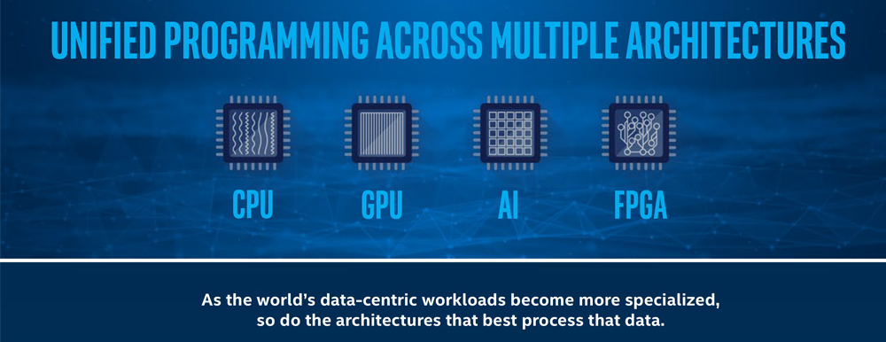
Intel oneAPI
Notes:
What is OneAPI
oneAPI is an open, cross-industry, standards-based, unified, multiarchitecture, multi-vendor programming model that delivers a common developer experience across accelerator architectures – for faster application performance, more productivity, and greater innovation. The oneAPI initiative encourages collaboration on the oneAPI specification and compatible oneAPI implementations across the ecosystem.
-visit https://www.oneapi.io/
-Explore Elements of oneAPI at url https://www.oneapi.io/spec/
-SPEC 1.1

Slide 10
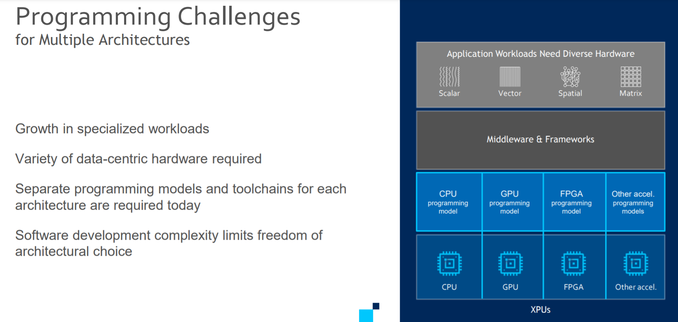

Slide 11
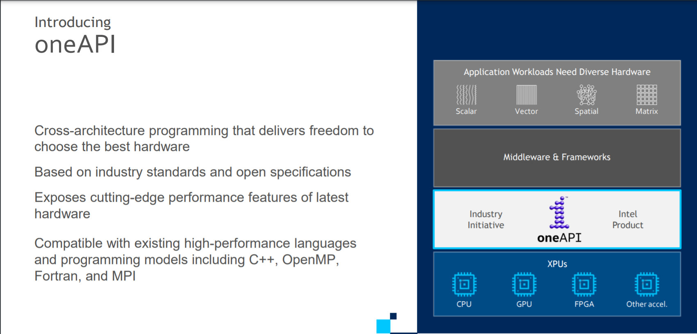

Slide 12
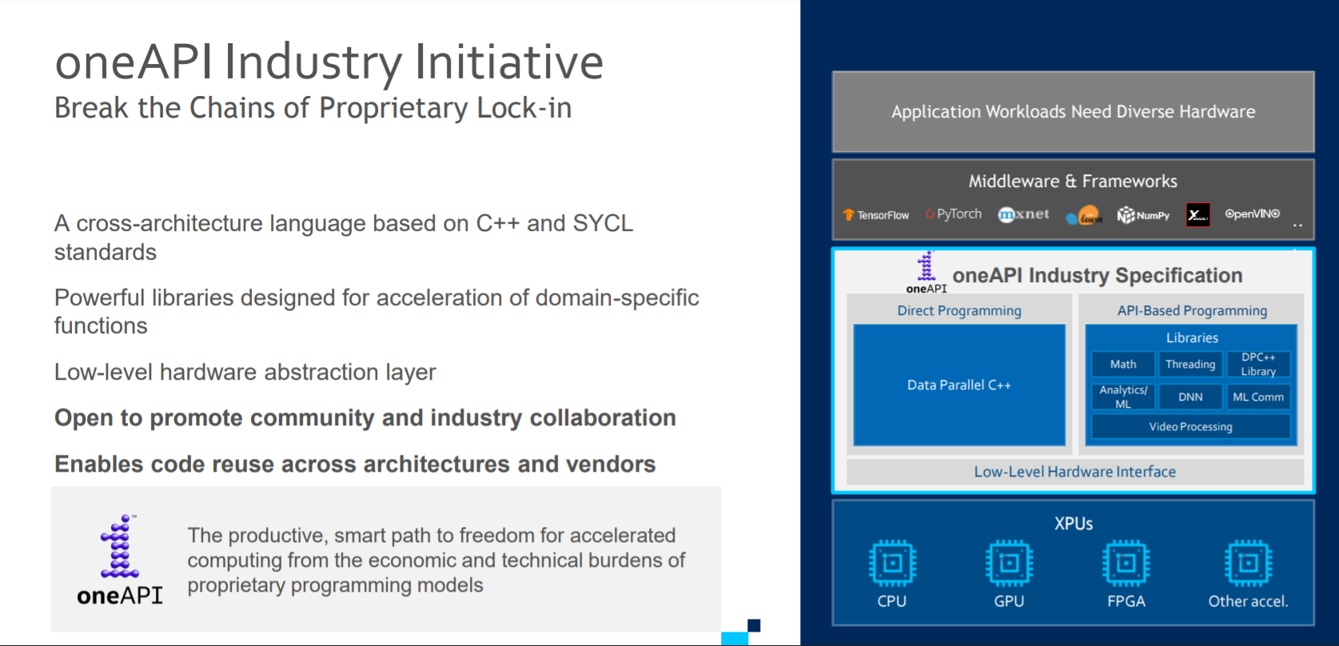

Slide 13
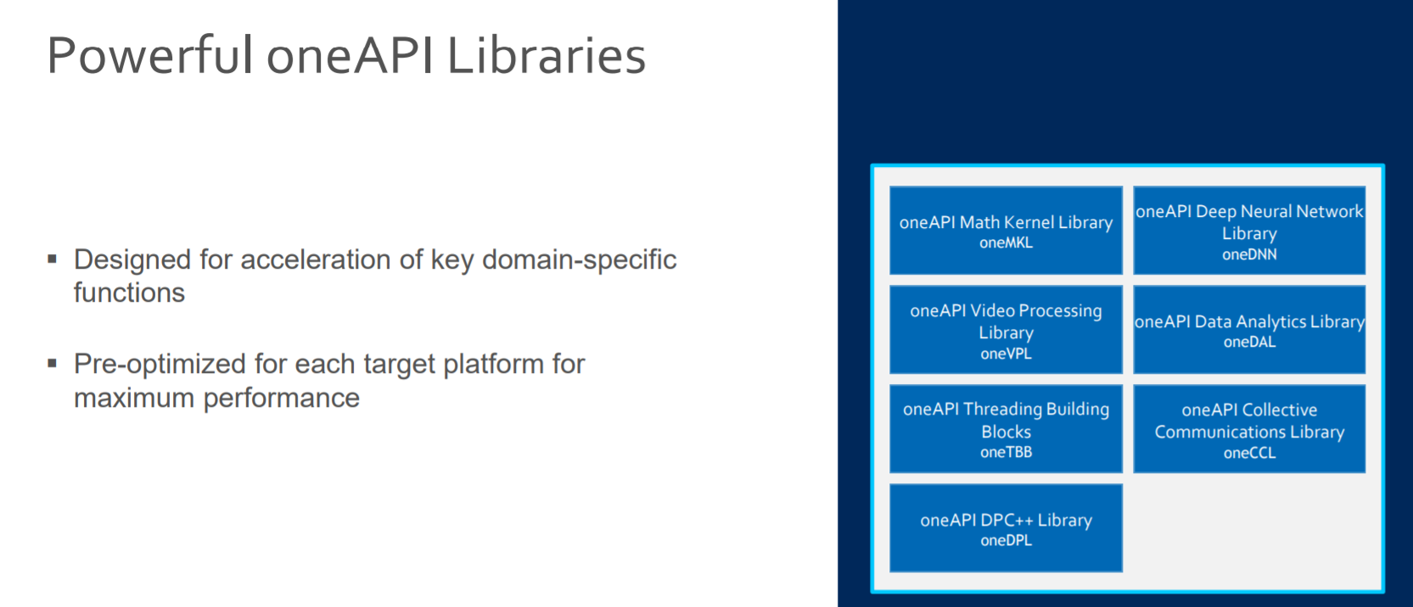

Slide 14
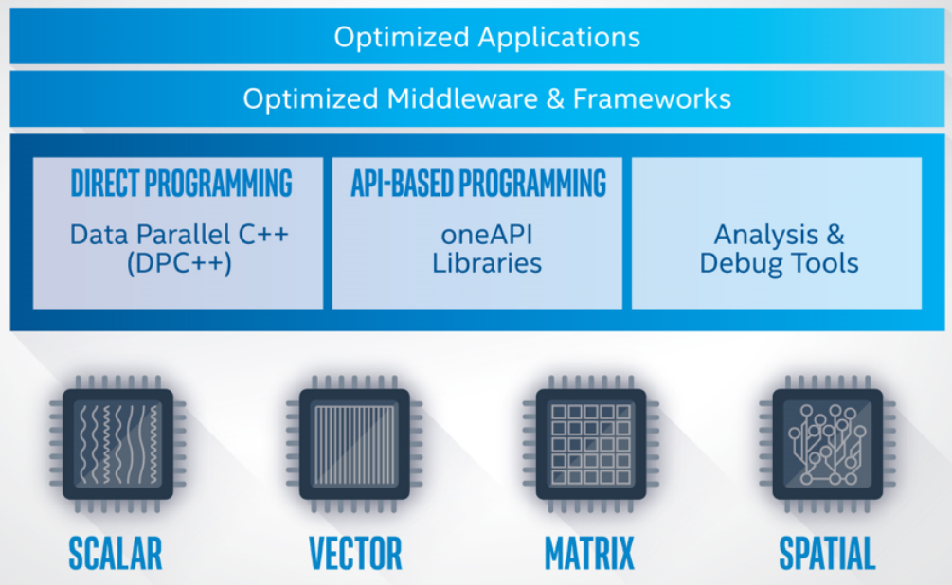
Intel OneAPI - Cross Architecture Performance
oneAPI is a cross-industry, open, standards-based unified programming model that delivers a common developer experience across accelerator architectures—for faster application performance, more productivity, and greater innovation.
The oneAPI industry initiative encourages collaboration on the oneAPI specification and compatible oneAPI implementations across the ecosystem.
Short Video Link
https://software.intel.com/content/www/us/en/develop/tools/oneapi.html#gs.36k4jr
Notes:
Intel Parallel Studio XE is a software development product developed by Intel that facilitates native code development on Windows, macOS and Linuxin C++ and Fortran for parallel computing.^{[2]} Parallel programming enables software programs to take advantage of multi-core processors from Intel and other processor vendors.
Intel Vtune amplifier- Stop guessing why software is slow. Advanced sampling and profiling techniques quickly analyze your code, isolate issues, and deliver insights for optimizing performance on modern processors.
Intel inspector- Locate and debug threading, memory, and persistent memory errors in applications early in the design cycle to avoid costly errors later.
Intel Advisor- Design and optimize high-performing code for modern computer architectures. Effectively use more cores, vectorization, and heterogeneous processing.

Slide 15
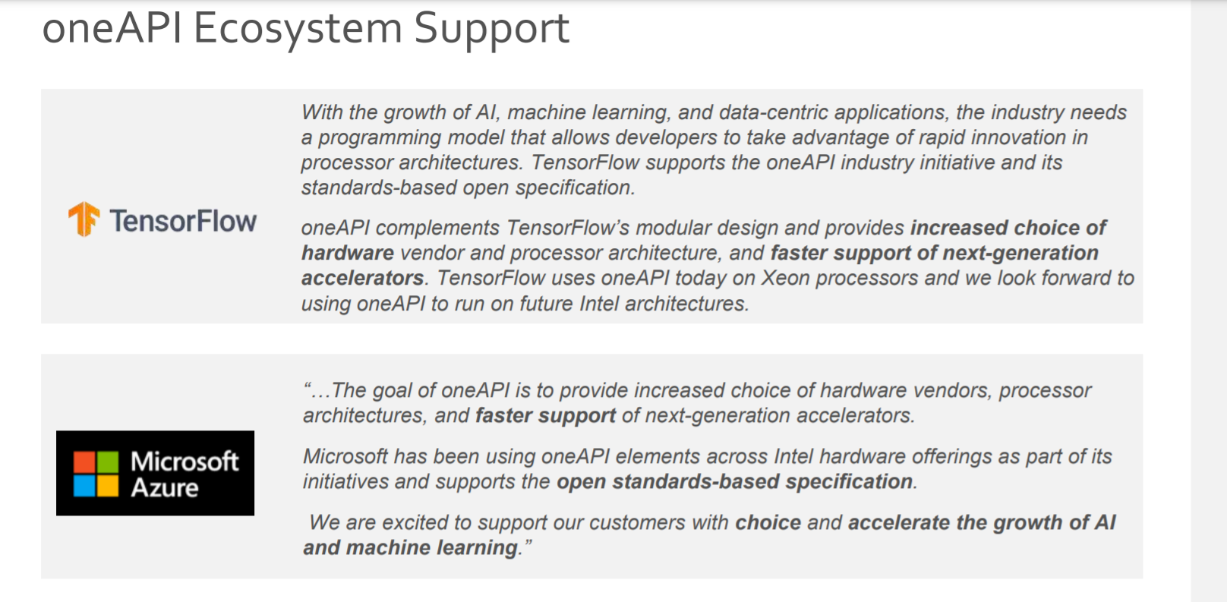

Slide 16
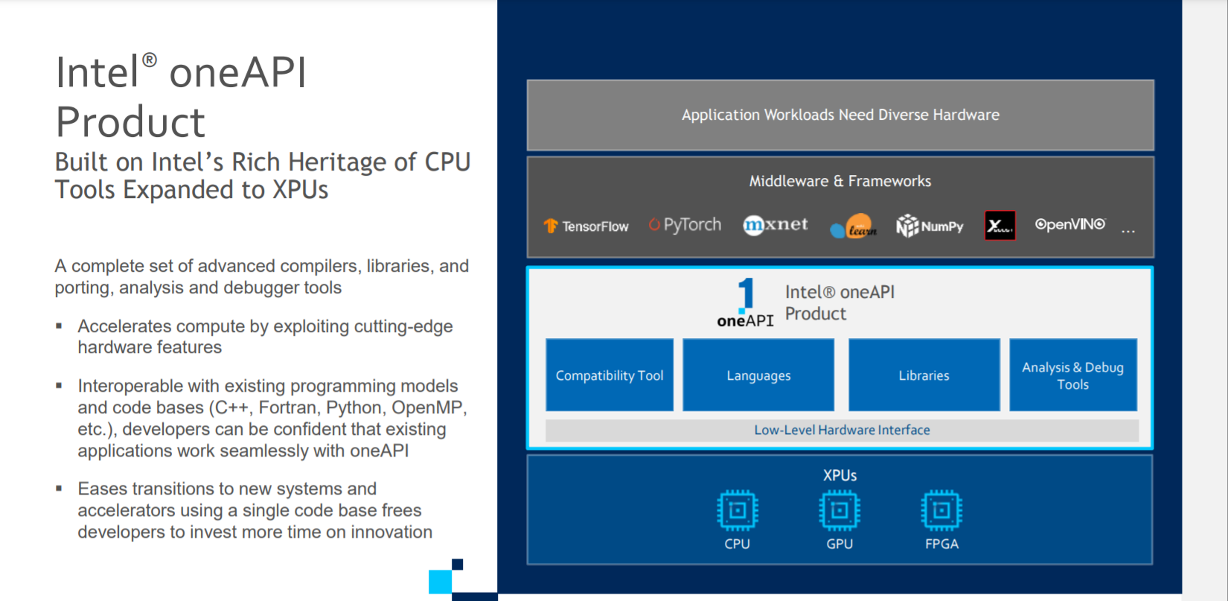

Slide 17
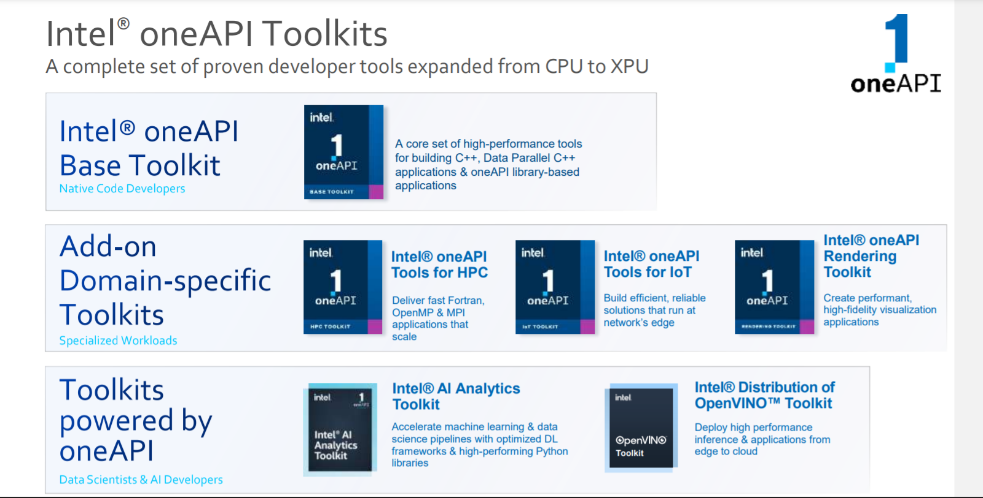

Slide 18
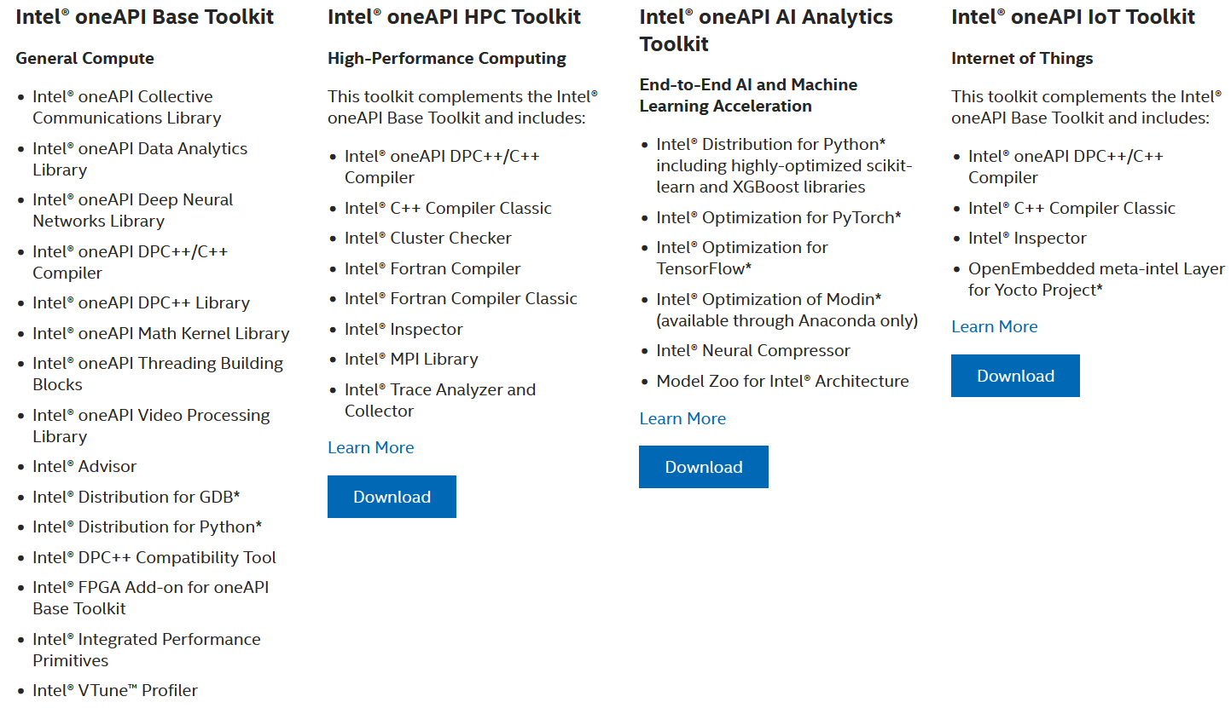
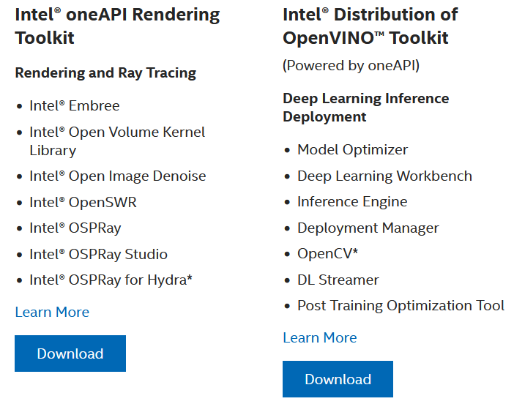
Intel OneAPI Toolkits
These toolkits are for performance-driven applications—HPC, IoT, advanced rendering, deep learning frameworks, and more—that are written in DPC++, C++, C, and Fortran languages.
Notes:
Intel Parallel Studio XE is a software development product developed by Intel that facilitates native code development on Windows, macOS and Linuxin C++ and Fortran for parallel computing.^{[2]} Parallel programming enables software programs to take advantage of multi-core processors from Intel and other processor vendors.
Intel Vtune amplifier- Stop guessing why software is slow. Advanced sampling and profiling techniques quickly analyze your code, isolate issues, and deliver insights for optimizing performance on modern processors.
Intel inspector- Locate and debug threading, memory, and persistent memory errors in applications early in the design cycle to avoid costly errors later.
Intel Advisor- Design and optimize high-performing code for modern computer architectures. Effectively use more cores, vectorization, and heterogeneous processing.

Slide 19
DPC++
oneAPI’s core language for programming accelerators and multiprocessors. DPC++ allows developers to reuse code across hardware targets (CPUs and accelerators such as GPUs and FPGAs) and tune for a specific architecture

Slide 20
OneDPL
A companion to the DPC++ Compiler for programming oneAPI devices with APIs from C++ standard library, Parallel STL, and extensions.
The oneAPI DPC++ Library (oneDPL) provides the functionality specified in the C++ standard, with extensions to support data parallelism and offloading to devices, and with extensions to simplify its usage for implementing data parallel algorithms.

Slide 21
OneDNN
High-performance implementations of primitives for deep learning frameworks
-oneAPI Deep Neural Network Library (oneDNN) is a performance library containing building blocks for for deep learning applications and frameworks. oneDNN supports:
CNN primitives (Convolutions, Inner product, Pooling, etc.)
RNN primitives (LSTM, Vanilla, RNN, GRU)
Normalizations (LRN, Batch, Layer)
Elementwise operations (ReLU, Tanh, ELU, Abs, etc.)
Softmax, Sum, Concat, Shuffle
Reorders from/to optimized data layouts
8-bit integer, 16-, 32-bit, and bfloat16 floating point data types

Slide 22
OneCCL
Communication primitives for scaling deep learning frameworks across multiple devices.
The oneAPI Collective Communications Library (oneCCL) provides primitives for the communication patterns that occur in deep learning applications. oneCCL supports both scale-up for platforms with multiple oneAPI devices and scale-out for clusters with multiple compute nodes.

Slide 23
Level Zero
A system interface for oneAPI languages and libraries

Slide 24
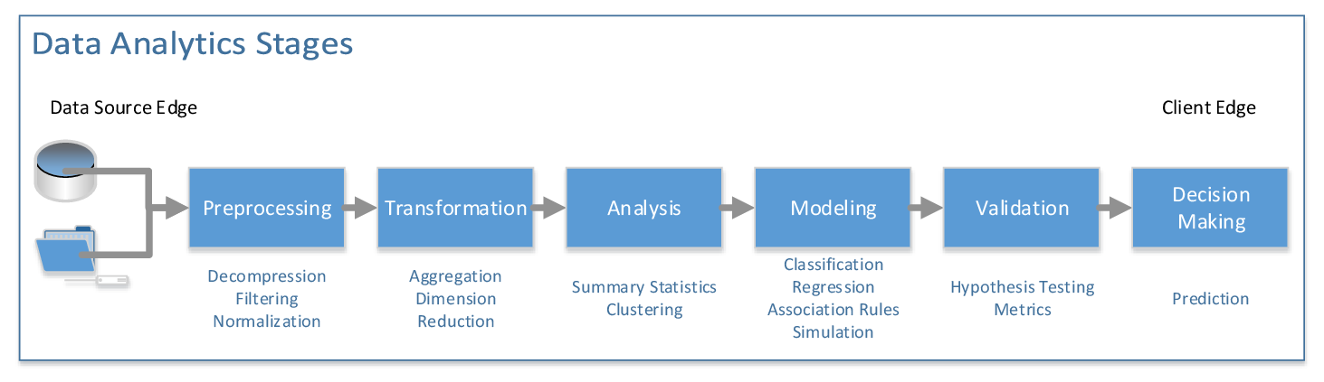
OneDAL
Algorithms for accelerated data science
oneDAL is a library that helps speed up big data analysis by providing highly optimized algorithmic building blocks for all stages of data analytics (preprocessing, transformation, analysis, modeling, validation, and decision making) in batch, online, and distributed processing modes of computation.

Slide 25
OneTBB
A library for adding thread-based parallelism to complex applications on multiprocessors.
oneTBB is a programming model for scalable parallel programming using standard ISO C++ code. A program uses oneTBB to specify logical parallelism in algorithms, while a oneTBB implementation maps that parallelism onto execution threads.

Slide 26
OneVPL
The oneAPI Video Processing Library (oneVPL) is a programming interface for video decoding, encoding, and processing to build portable media pipelines on CPUs, GPUs, and other accelerators. It provides device discovery and selection in media centric and video analytics workloads and API primitives for zero-copy buffer sharing. oneVPL is backwards and cross-architecture compatible to ensure optimal execution on current and next generation hardware without source code changes.

Slide 27
OneMKL
High-performance math routines for science, engineering, and financial applications
The oneAPI Math Kernel Library (oneMKL) defines a set of fundamental mathematical routines for use in high-performance computing and other applications. As part of oneAPI, oneMKL is designed to allow execution on a wide variety of computational devices: CPUs, GPUs, FPGAs, and other accelerators. The functionality is subdivided into several domains: dense linear algebra, sparse linear algebra, discrete Fourier transforms, random number generators and vector math.

Slide 28
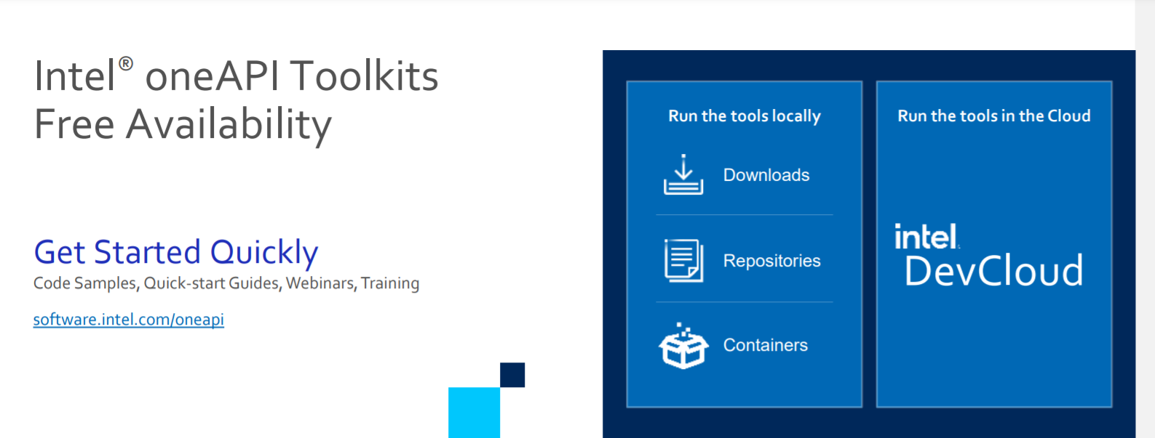
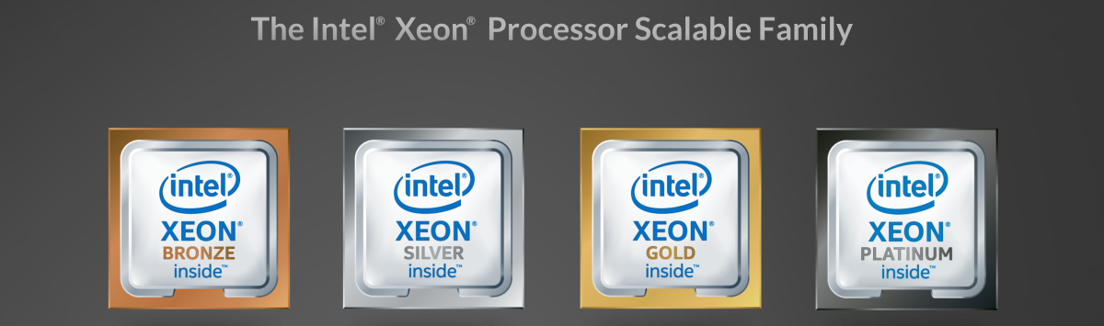
What is Intel Dev Cloud ?

Slide 29
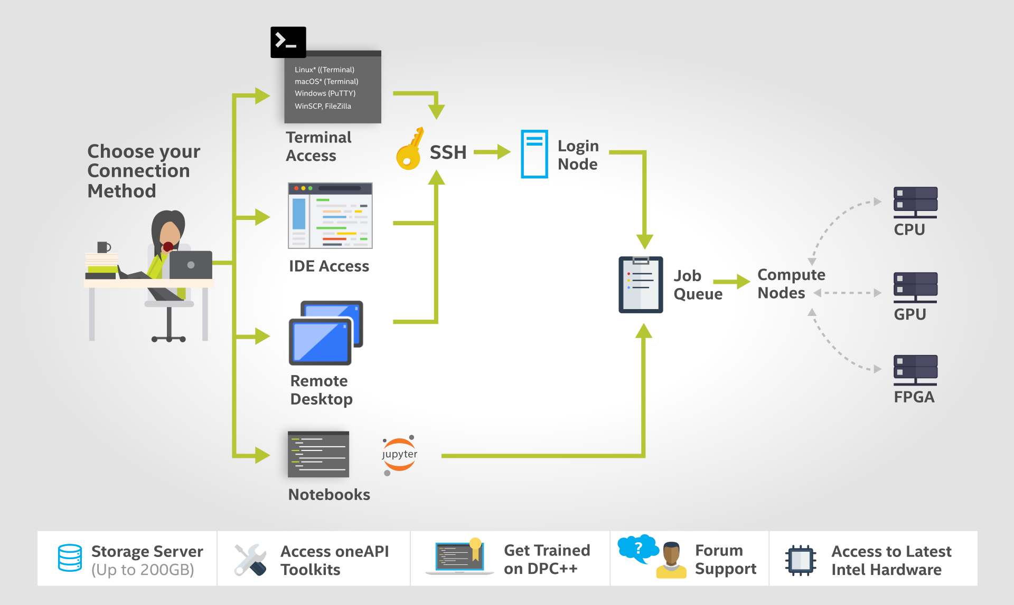
How DevCloud works?

Slide 30
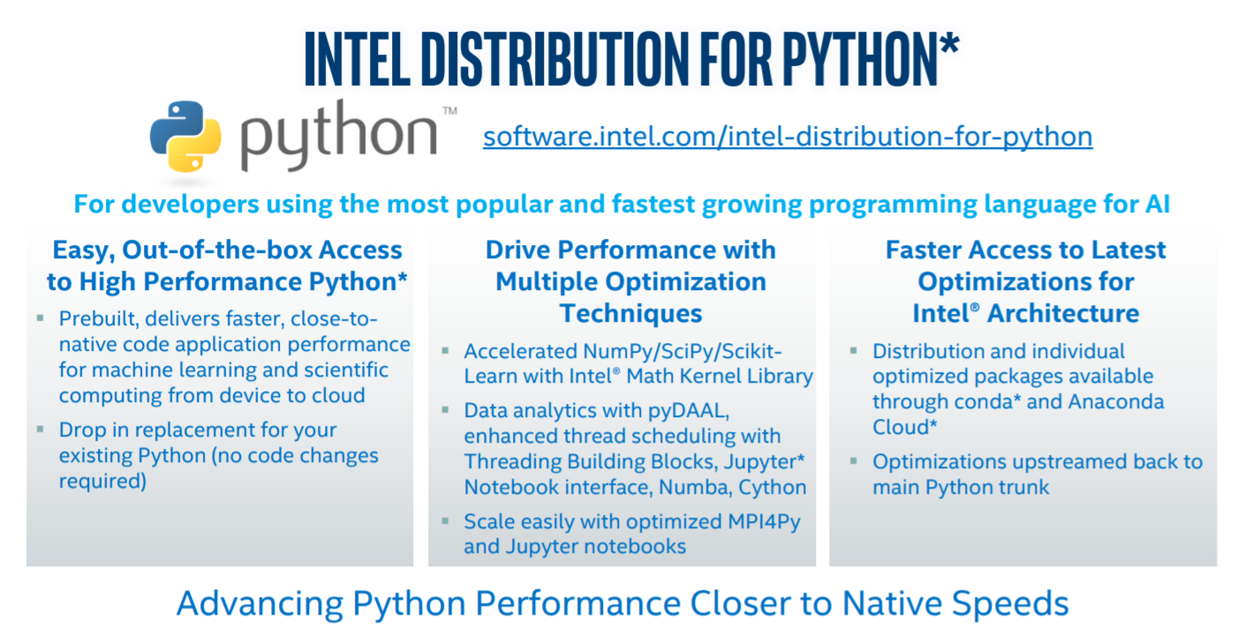

Slide 31
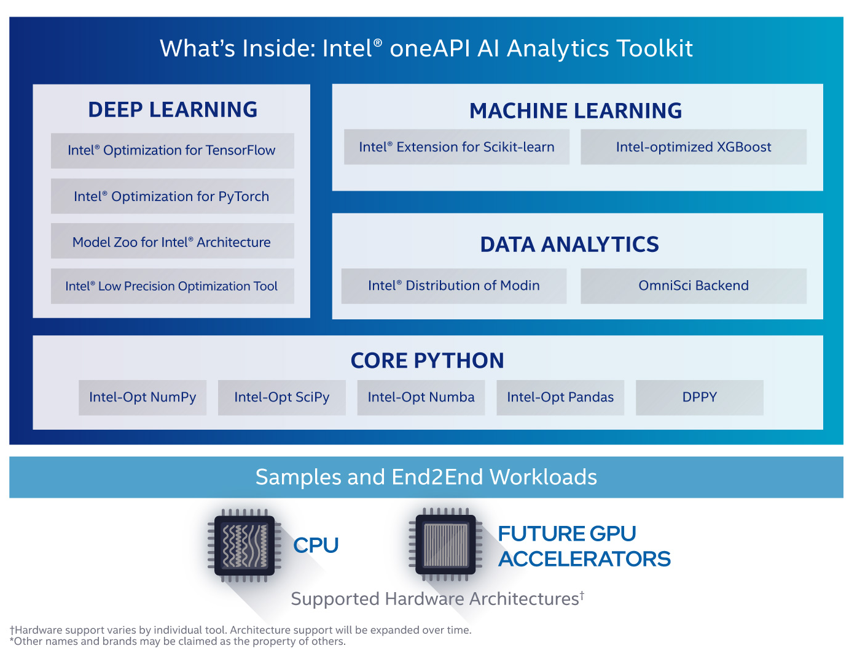

Slide 32
What software are required for this workshop?
Anaconda Software on Ubuntu
Intel Distribution of Python
Intel DevCloud for OneAPI

Slide 33
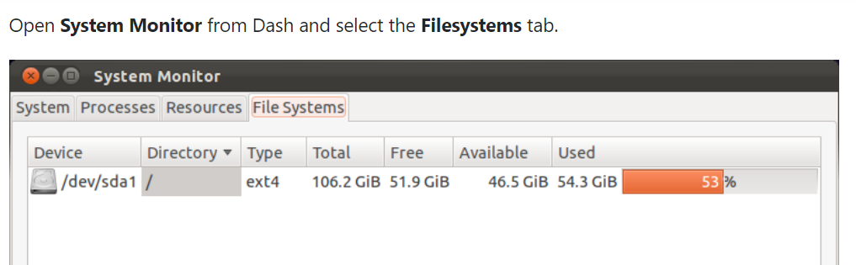
Important Ubuntu Commands
Check Ubuntu version
lsb_release –a
cat /etc/issue.net
Check Disk Space
df -h

Slide 34

Steps for downloading Intel Distribution of Python
Download Anaconda/Miniconda software
https://docs.anaconda.com/anaconda/install/linux/
Check Conda version
conda --version
Update Anaconda package
conda update conda

Slide 35
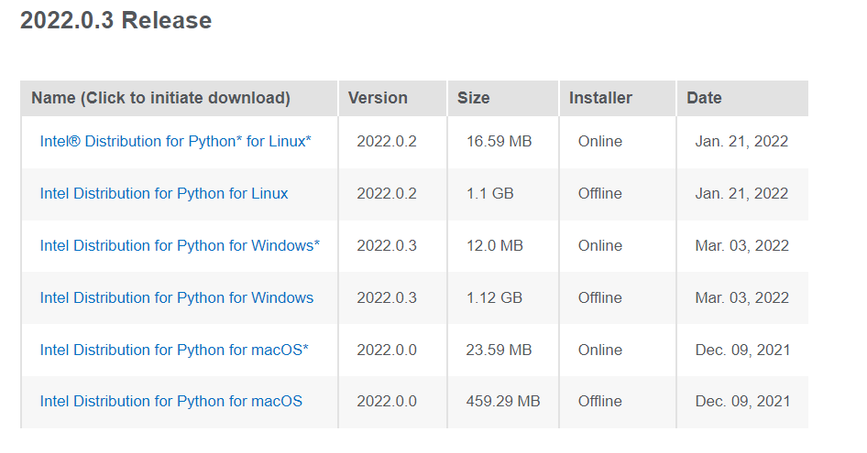
Intel Distribution of Python
https://www.intel.com/content/www/us/en/developer/articles/tool/oneapi-standalone-components.html#python

Slide 36
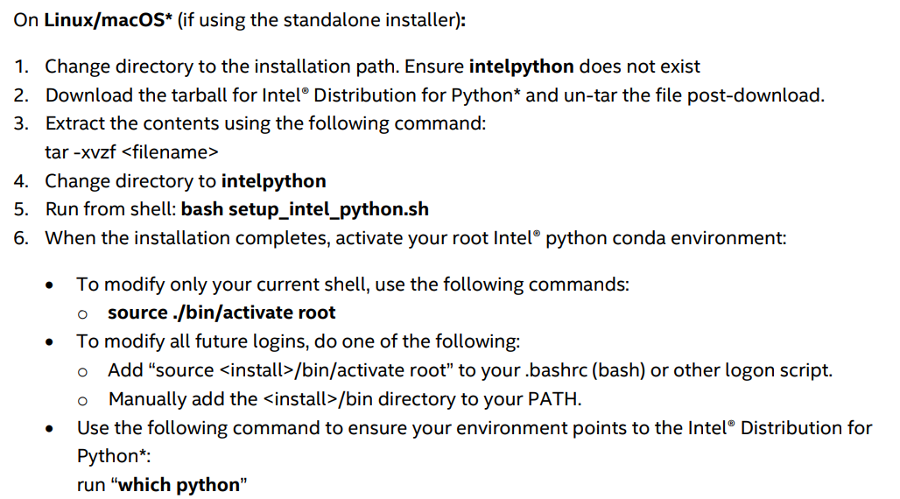
Intel Distribution of Python
https://www.intel.com/content/dam/develop/external/us/en/documents/2022_Python_Release_Notes_Intel(R)_Distribution_for_Python-Release1.pdf

Slide 37
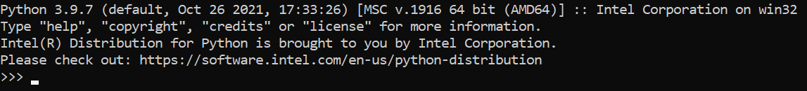
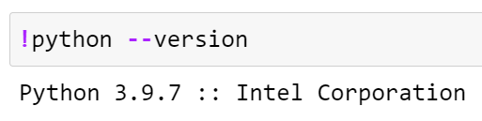
Checking if Python Intel is installed or not
On Anaconda Prompt, type python
In Jupyter Notebook, check the above statement in the code cell
Notes:
https://www.intel.com/content/www/us/en/developer/articles/tool/oneapi-standalone-components.html#python

Slide 38
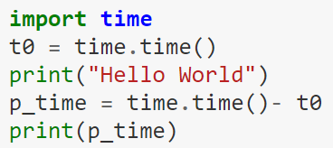
Time module in Python
%time
Use of time module from Python Standard library

Slide 39
How AI can be useful in agriculture
According to the Food and Agriculture Organization survey, the world population is expected to grow by another two billion by 2050, while the arable area is likely to grow only by 5%.
Farming entails a great deal of uncertainties such as climatic changes, fluctuating cost of agricultural material, crop damage by pests, etc.
Therefore, to increase the agriculture productivity efficient farming practises are required.
By using AI technology, the impact on natural ecosystems can be reduced which will help to keep food prices low and ensure that food production will keep up with the growing population.

Slide 40
Advantages
Analyzing market demand
AI can simplify crop selection and help farmers identify what produce will be most profitable.
Managing risk
Farmers can use forecasting and predictive analytics to reduce errors in business processes and minimize the risk of crop failures.

Slide 41
Advantages
Breeding seeds
By collecting data on plant growth, AI can help produce crops that are less prone to disease and better adapted to weather conditions.
Monitoring soil health
AI systems can conduct chemical soil analyses and provide accurate estimates of missing nutrients.

Slide 42
Advantages
Protecting crops
AI can monitor the state of plants to spot and even predict diseases, identify and remove weeds, and recommend effective treatment of pests.
Feeding crops
AI is useful for identifying optimal irrigation patterns and nutrient application times and predicting the optimal mix of agronomic products.
Harvesting
With the help of AI, it’s possible to automate harvesting and even predict the best time for it.

Slide 43
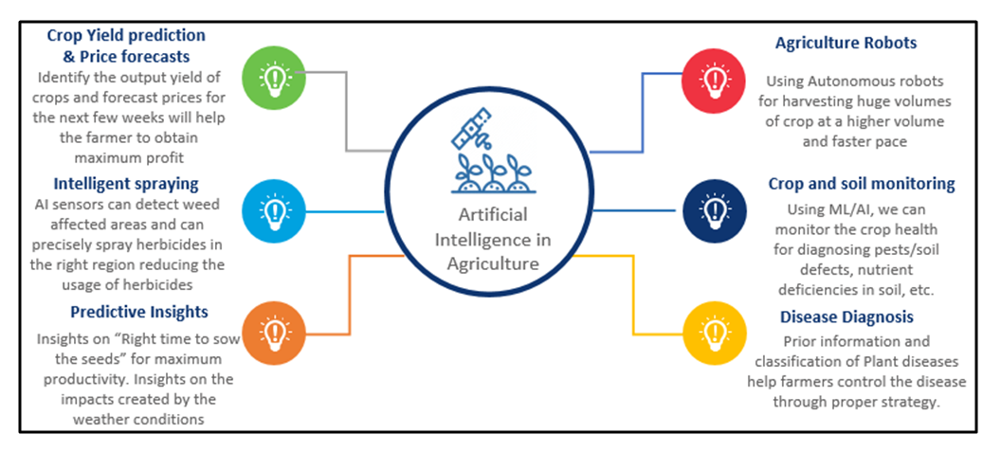
AI in Agriculture
Crop Yield prediction and Price forecasts
Agriculture Robots
Intelligent Spraying
Predictive Insights
Crop and soil monitoring
Disease Diagnosis
Source: https://www.wipro.com/holmes/towards-future-farming-how-artificial-intelligence-is-transforming-the-agriculture-industry.

Slide 44
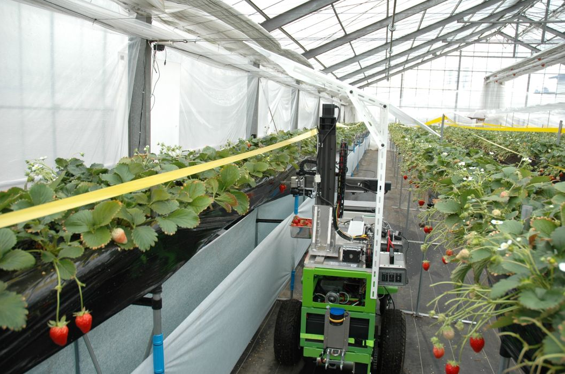
Harvesting Robot
It is made possible by using a stereo vision camera (basically allowing the robot to “see” in 3D like humans can) to discern where the strawberries are.
Specialized software quickly analyzes them to differentiate ripe from unripe berries.
The robotic arm is extended to the analyzed strawberry where its three fingers clamp the strawberry, pluck it from the strawberry plant, and deposit it onto a conveyor belt.
Source: http://www.lovingthemachine.com/2008/04/farmer-hails-strawberry-picking-robot.html

Slide 45
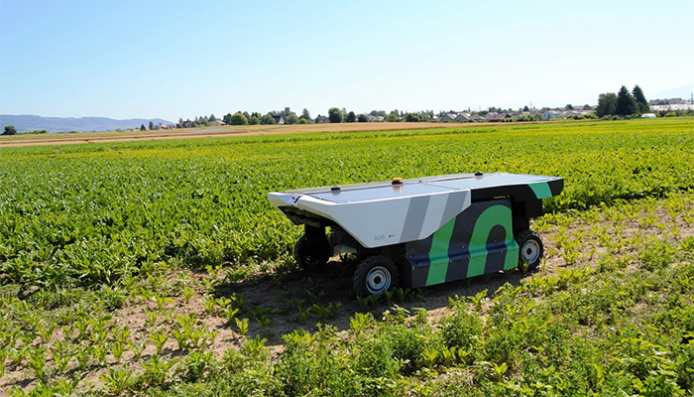
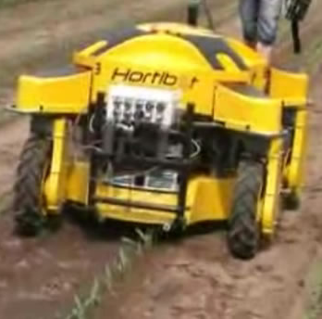
Weeding Robot
It helps to ensure a smaller environmental footprint.
It works by identifying flora that are dissimilar to the selected cultivar.
It ignores the crops, targeting the weed with a mini dose of herbicide, allowing farmers to use 90 percent less.
Source: https://www.roboticsbusinessreview.com/agriculture/the-next-frontier-of-weeding-robots/

Slide 46
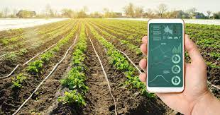
Crop health monitoring
Soil condition monitoring sensors allow farmers to collect data about rainfall, temperature, and other metrics over time to track trends and predict irrigation needs.
Farmers will save time that’s usually spend manually checking crop water levels because sensors can give them real-time information instantly on almost any online device.
Sensors allow for better water conservation while ensuring there isn’t over or underwatering of crops.
IOT-enabled sensors take very little time to set up and there is a long battery life, which leads to less maintenance costs.
Source: https://www.biz4intellia.com/blog/crop-health-monitoring-with-iot-enabled-precision-agriculture-solution/

Slide 47
Role of Intel in Agriculture
A new project launched by the International Fund for Agricultural Development (IFAD) and Intel Corporation is providing smallholder farmers in the Kingdom of Cambodia simple technologies that can help the country reach its goal of becoming the next major rice exporter in the global market.
The new project provides smallholder farmers a step-by-step software programme to analyse soil, determine fertiliser requirements, advise on best seeds and deal with pests and diseases.
The software gives them immediate access to a pool of specialists and all the knowledge they need is at their fingertips.
The software from Intel corporation is being used in India, where it has helped small farmers increase their production by around 300 per cent.

Slide 48
Conclusion
The benefits of AI in agriculture are undeniable.
Smart farming tools and vertical farming systems can perform small, repeatable, and time-consuming tasks so farm workers can use their time for more strategic operations that require human intelligence.
However, it’s important to realize that unlike a tractor, one can’t just buy AI and start it.
AI is just the next step in the development of smart farming, and it needs other technology to actually work.

Slide 49
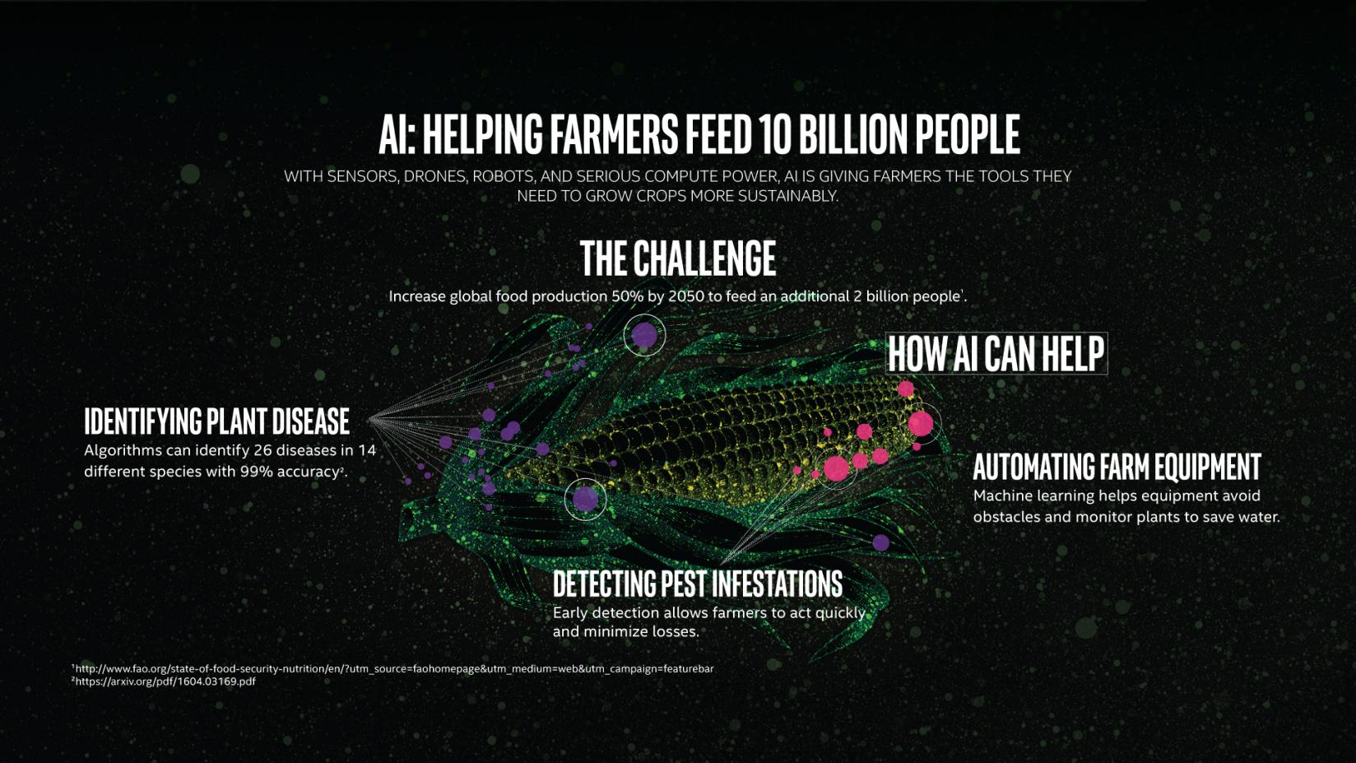
Conclusion
Source: https://www.intel.com/content/www/us/en/big-data/article/agriculture-harvests-big-data.html

Slide 50

Please contact
Foundation for Innovation and Collaborative
Education
mentor@fice.in
www.fice.in
Please contact
Foundation for Innovation and Collaborative
Education
info@fice.in
mentor@fice.in
Notes:
Here are the lessons we are going to learn today.

